Slide 2
A Pure Conscience
Hebrews 9:13-14

Slide 3
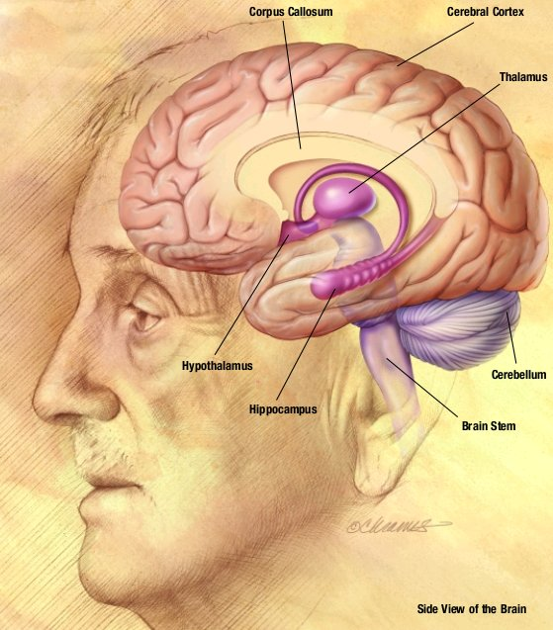
con·science
ˈkänCHəns/
noun: conscience; Definition: an inner feeling or voice viewed as acting as a guide to the rightness or wrongness of one's behavior.
“He had a guilty conscience about his mistake."

Slide 4
A Pure
Conscience
HEBREWS 9
“13 For if the blood of bulls and of goats, and the ashes of an heifer sprinkling the unclean, sanctifieth to the purifying of the flesh:
14 How much more shall the blood of Christ, who through the eternal Spirit offered himself without spot to God, purge your conscience from dead works to serve the living God?”

Slide 5
conscience
alls out to us when we do wrong, Romans 2:14.
nly contains what it is taught, Acts 23:1.
ot always a safe guide, 1 Timothy 4:2.
erves our good, Romans 13:4-5.
an be strong or weak, 1 Corinthians 8:12.
nseparably tied to behavior and the Judgment, Acts 24:14-16.
xhorts us to grow in Christ, 1 Timothy 1:5; 1 Peter 3:15-16.
ot the same with everyone, 1 Peter 3:21.
an be silenced or ignored, 2 Corinthians 4:1-2.
nergizes and assures, Romans 9:1.

Slide 6
Hear the Gospel
Acts 2:22
Believe the Gospel
Acts 8:37a
Repent of Sins
Acts 2:38
Confess Christ
Acts 8:37b
Be Baptized
Acts 2:38
THE GOSPEL PLAN OF SALVATION
“The Lord added to the church daily” Acts 2:47
“Be thou faithful unto death” Revelation 2:10

